Slide 1
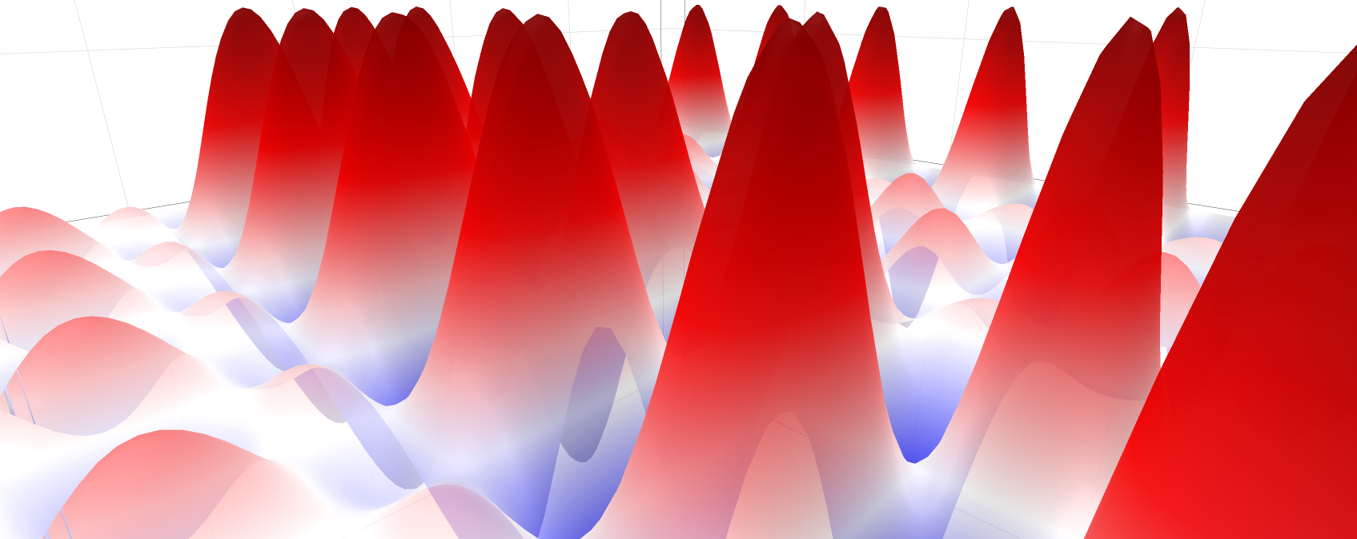
Variational quantum algorithms with single-pulse controlled arbitrary phase gates
Nathan Lacroix, C. K. Andersen, C. Hellings, A. Remm, S. Lazăr, G. Norris, S. Krinner, C. Eichler, A. Wallraff.

Slide 2
Motivation

Slide 3
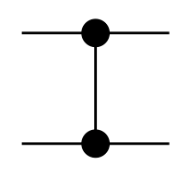
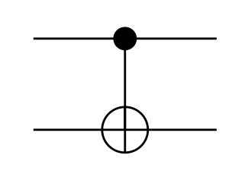
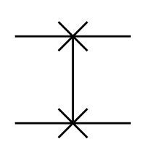
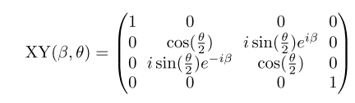
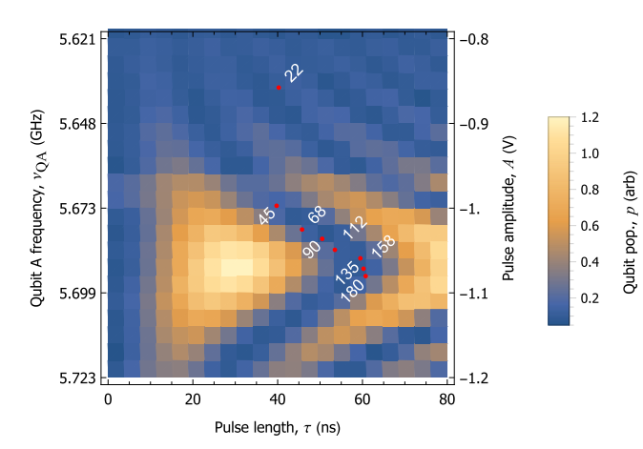
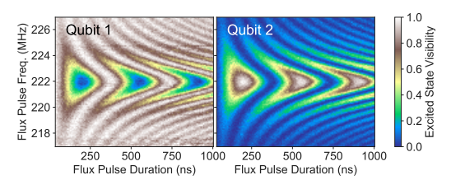
Motivation
Near term Intermediate Scale Quantum (NISQ) Era Error Corrected Era
Limited number of operations for fixed T1, T2
Common two qubit gates
Can we increase the number of operations by calibrating other gates ?
Abrams, D.M. et al. (2019)
Heinsoo, J. (2019)

Slide 4
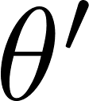
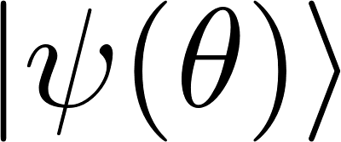
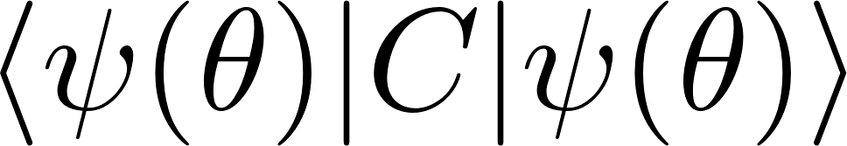
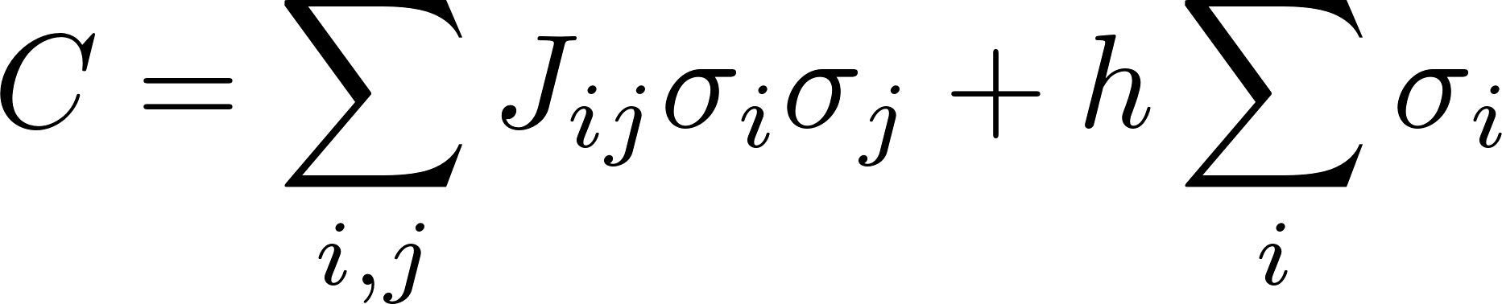
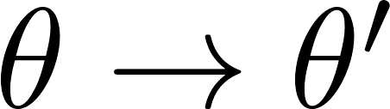
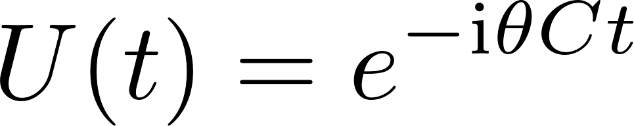
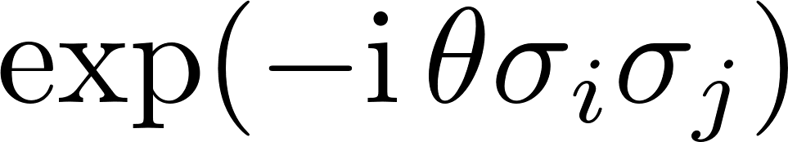
NISQ Algorithms
hybrid quantum-classical algorithms
includes terms
Fermionic problem
1. Prepare trial state
1. Compute Energy
Qubit Hamiltonian
Ground state
(approximate solution)
2. Measure expectation
values
2. Find better control
parameters
Classical optimization
problem
Arbitrary phase
VQE, QAOA, QAOAnsatz
Notes:
Hybrid Quantum-Classical algorithm:
In this scheme, we use a quantum processor to prepare an n-qubit state, then measure all the qubits and process the measurement outcomes using a classical optimizer; this classical optimizer instructs the quantum processor to alter slightly how the n-qubit state is prepared. This cycle is repeated many times until it converges to a quantum state from which the approximate solution can be extracted.
When applied to classical combinatorial optimization problems, this procedure goes by the name Quantum Approximate Optimization Algorithm (QAOA) [24]. But it can also be applied to quantum problems, like finding low-energy states of many-particle quantum systems (large molecules, for example). When applied to quantum problems this hybrid quantum-classical procedure goes by the name Variational Quantum Eigensolver (VQE) [25

Slide 5
Controlled Arbitrary Phase Gate (C-ARB)
How do we calibrate a C-ARB gate ?
Performance assessment ?
Benchmark on algorithm instance.

Slide 6
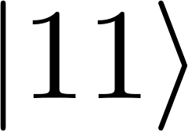
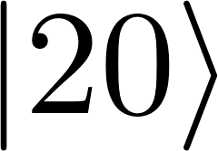
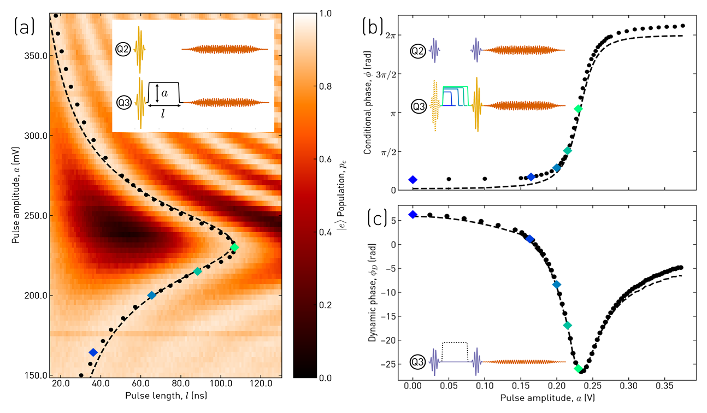
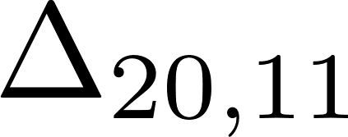
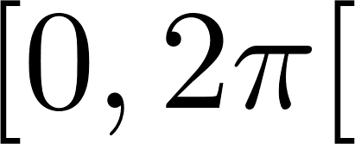
Calibration of a C-ARB gate
Bring and levels into interaction
Acquired phase depends on
High resolution sweep of flux pulse amplitude and length
Find lengths resulting in full population recovery in the computational subspace
Find amplitudes required to achieve phases in
Calibrate dynamic phase of fluxed qubit
DiCarlo, Strauch

Slide 7
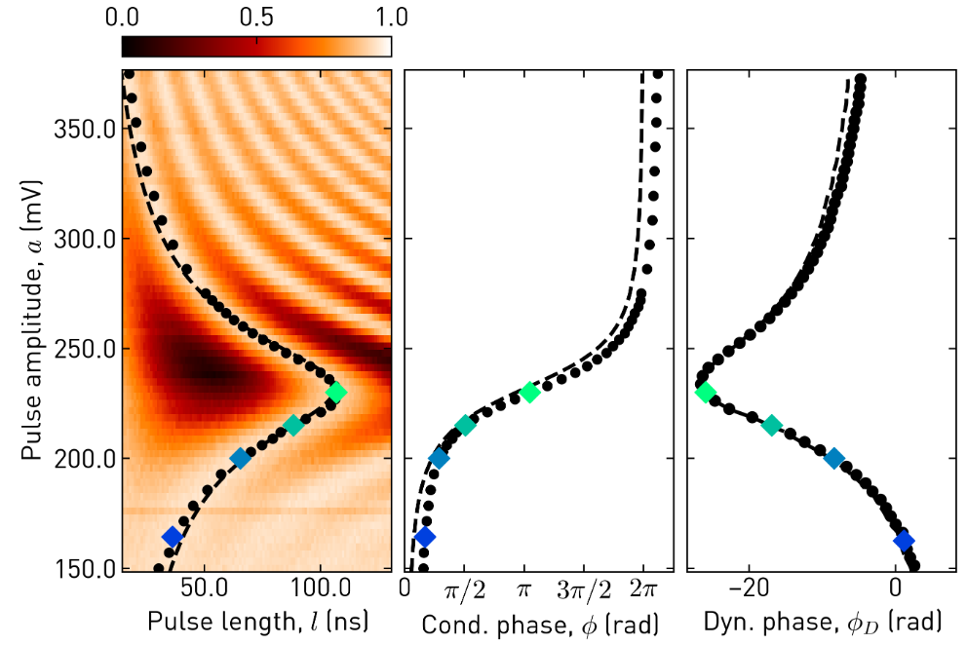
Calibration of a C-ARB gate
Bring and levels into interaction
Acquired phase depends on
High resolution sweep of flux pulse amplitude and length
Find lengths resulting in full population recovery in the computational subspace
Find amplitudes required to achieve phases in
Calibrate dynamic phase of fluxed qubit
DiCarlo, Strauch

Slide 8
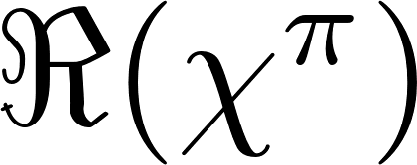
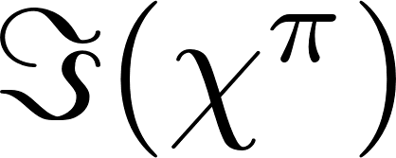
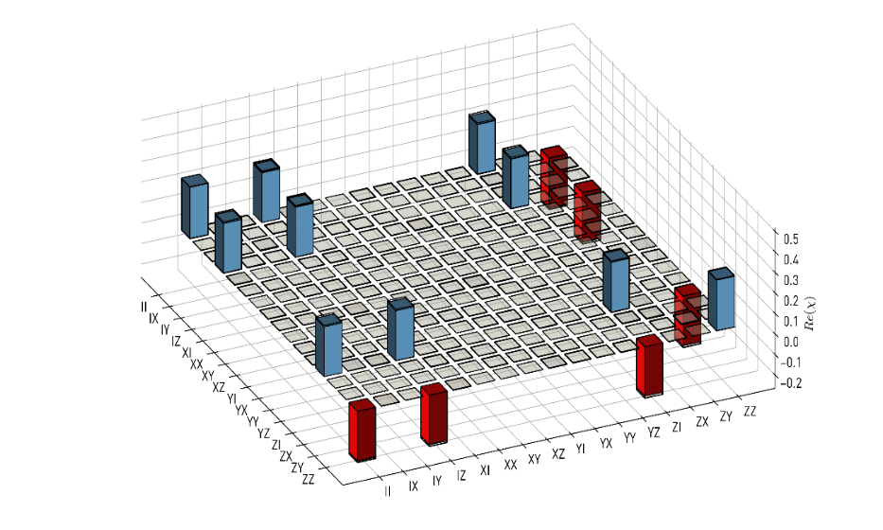
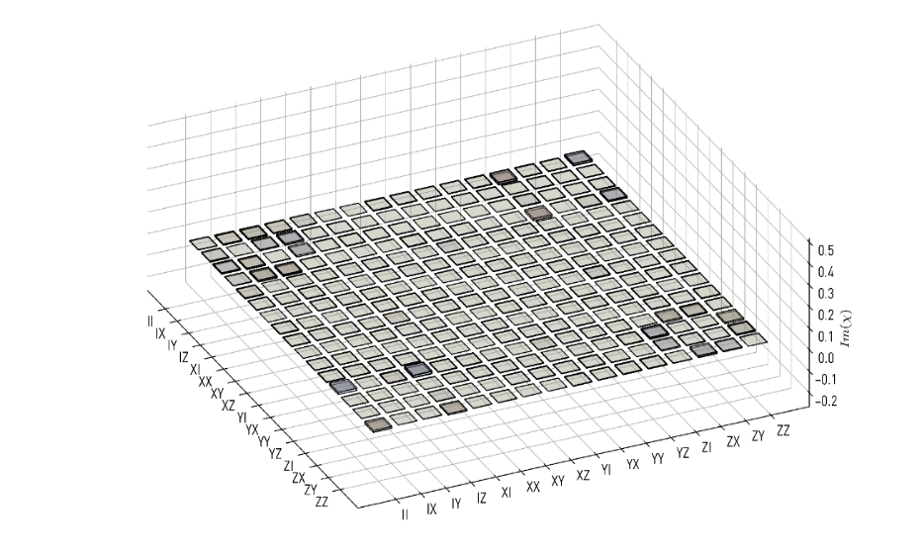
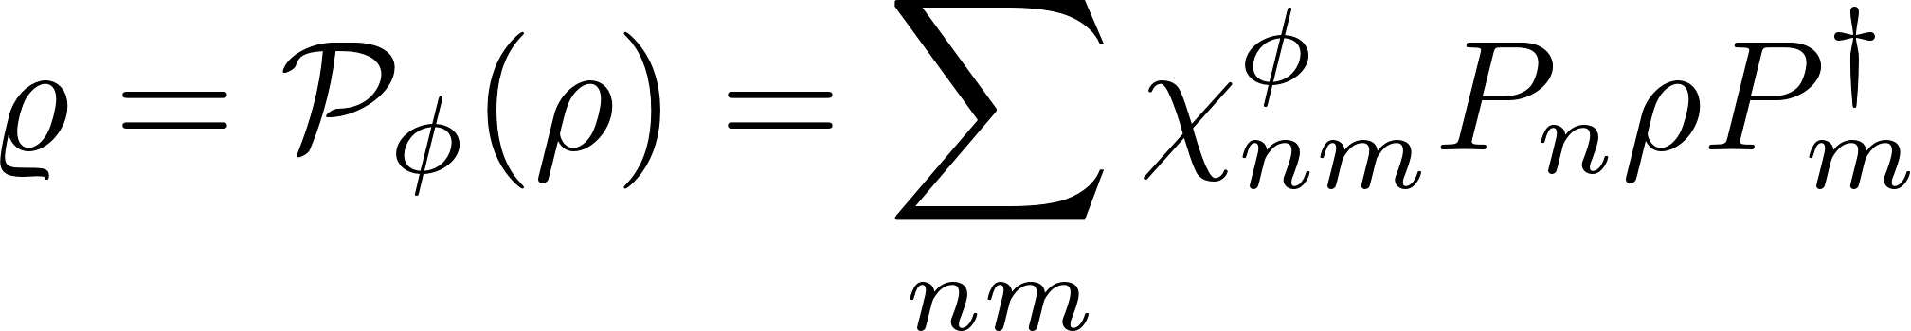
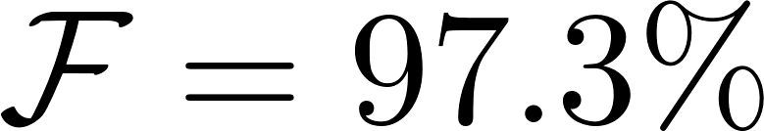
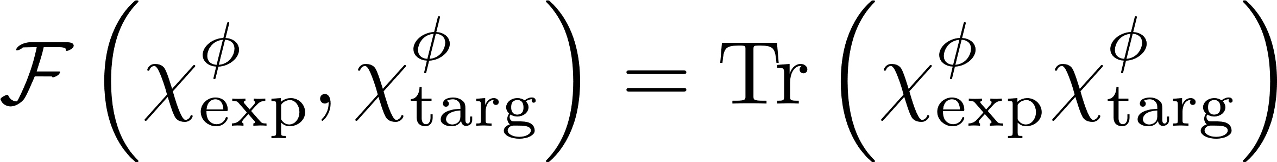
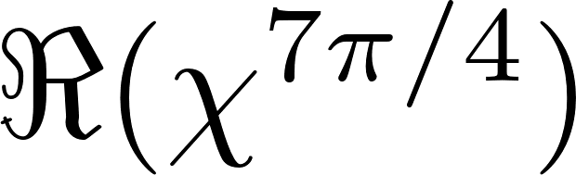
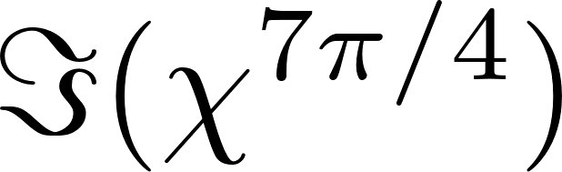
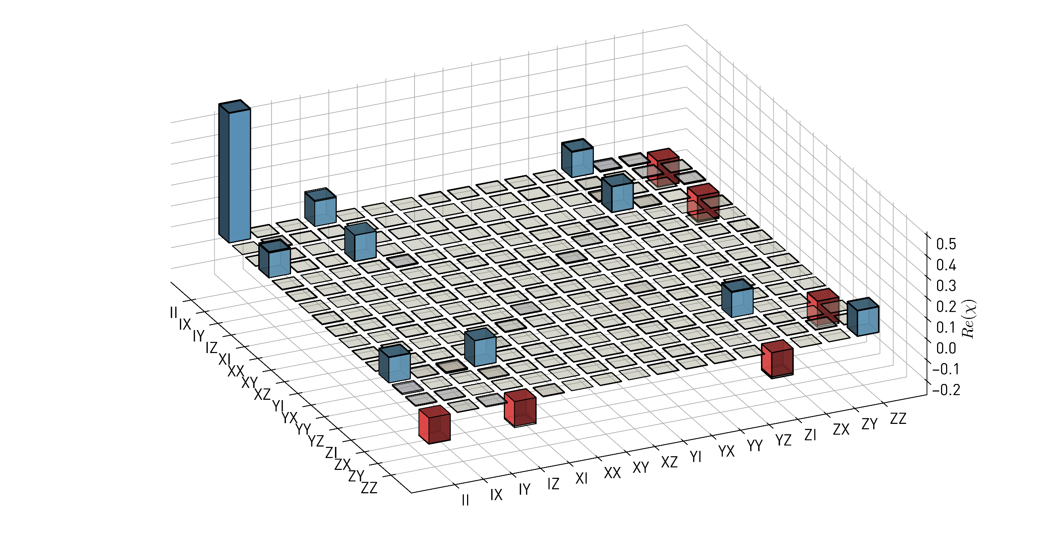
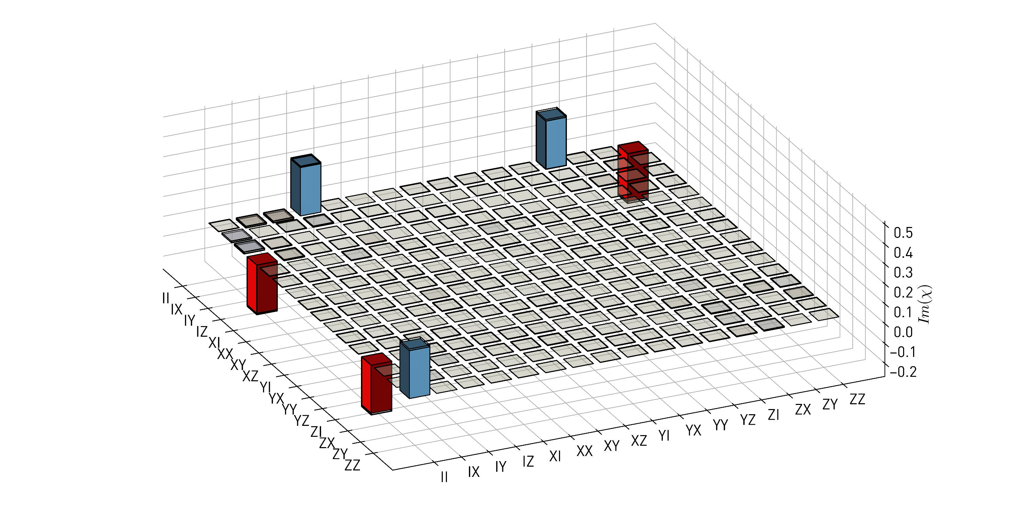
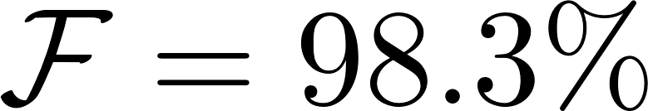
Process Tomography
Use 3 Level readout → Leakage characterized separately
Process fidelity
Repeat for different rotation angles

Slide 9
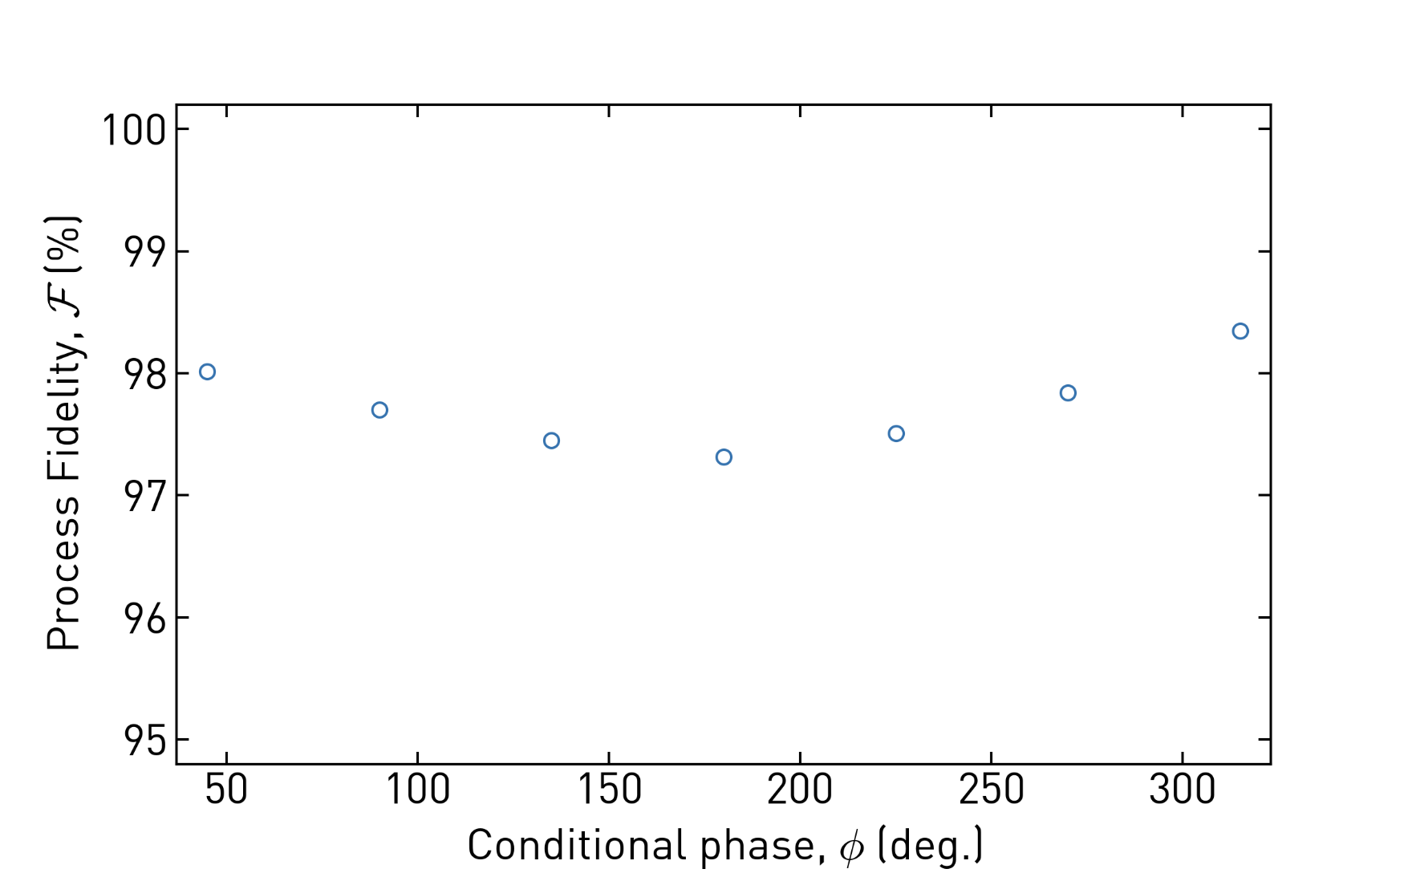
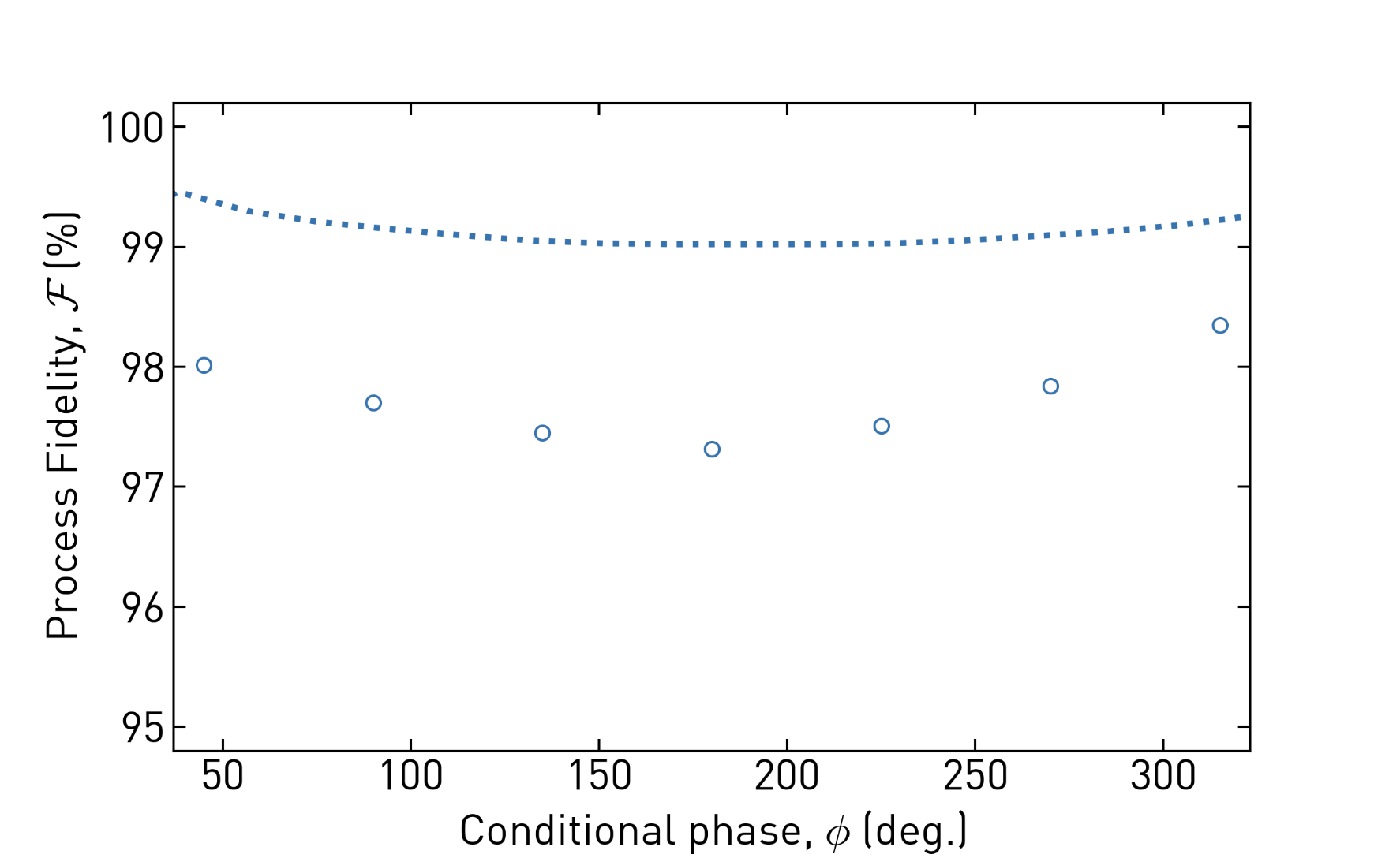
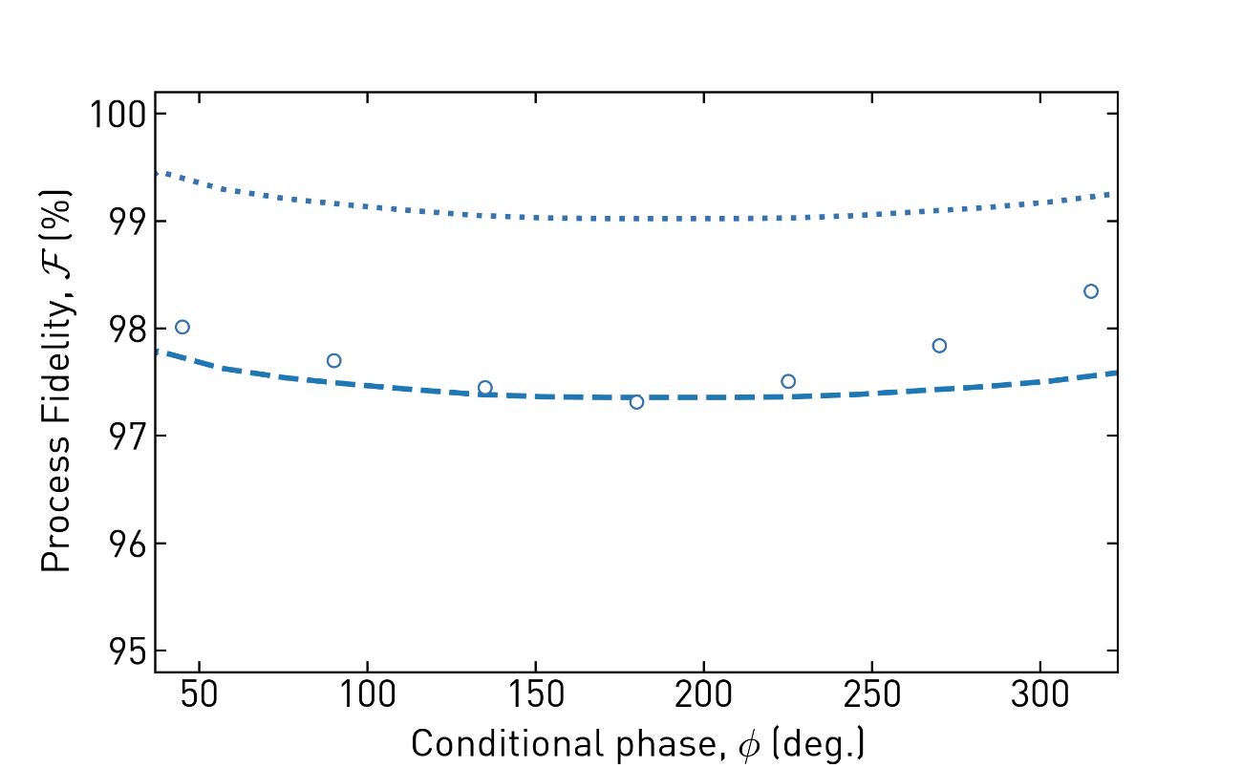
Process Tomography
Use 3 Level readout → Leakage characterized separately
Process fidelity
Repeat for different rotation angles
97.3% < Fidelity < 98.3 %
Notes:
Why no preselection ?
Goal was to use active reset, but could not due to firmware upgrade
XLD has much cooler qubits
Not crucial for comparison with CZ

Slide 10
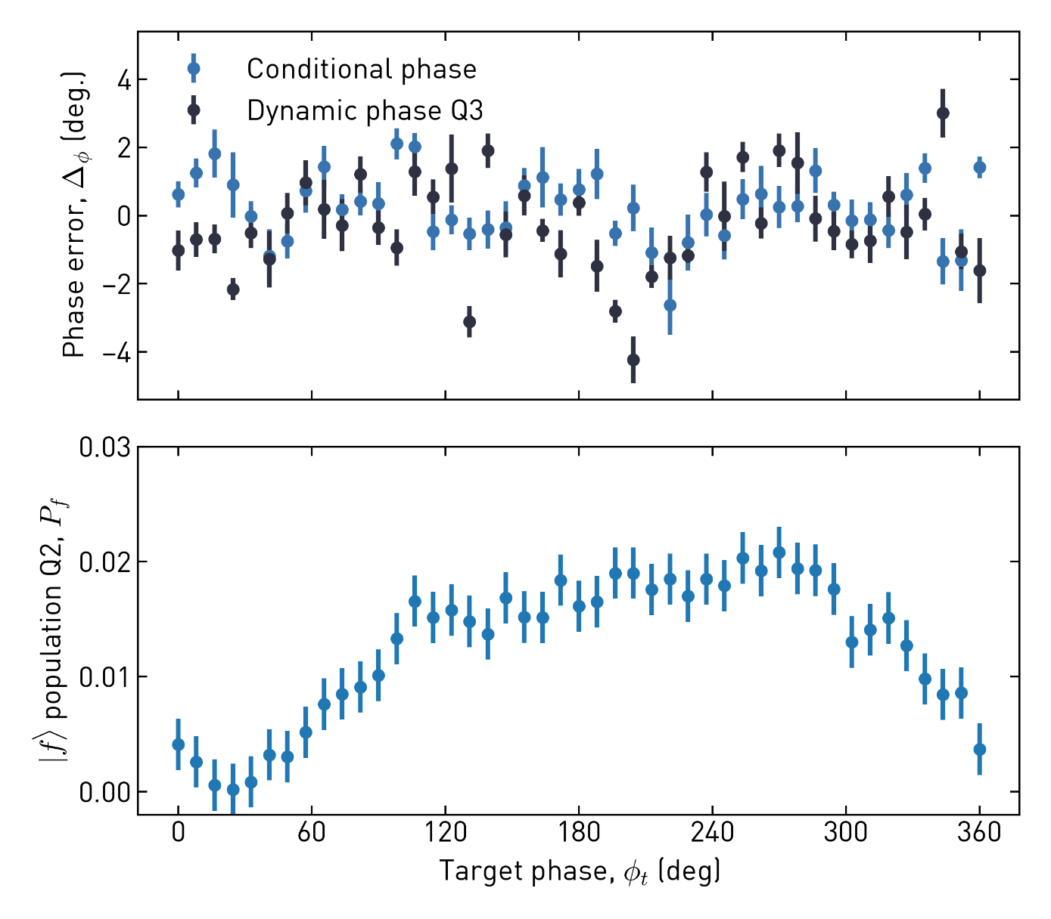
Phase errors and leakage characterization
Interpolation results in phase errors and leakage
Phase errors → < 0.1 % gate infidelity
Negligeable compared to eg. residual zz coupling.
Average leakage : 1.4 % (max 2 %) Largest near resonance. Mostly attributed to frequency oscillations not corrected by the FIR filters.

Slide 11
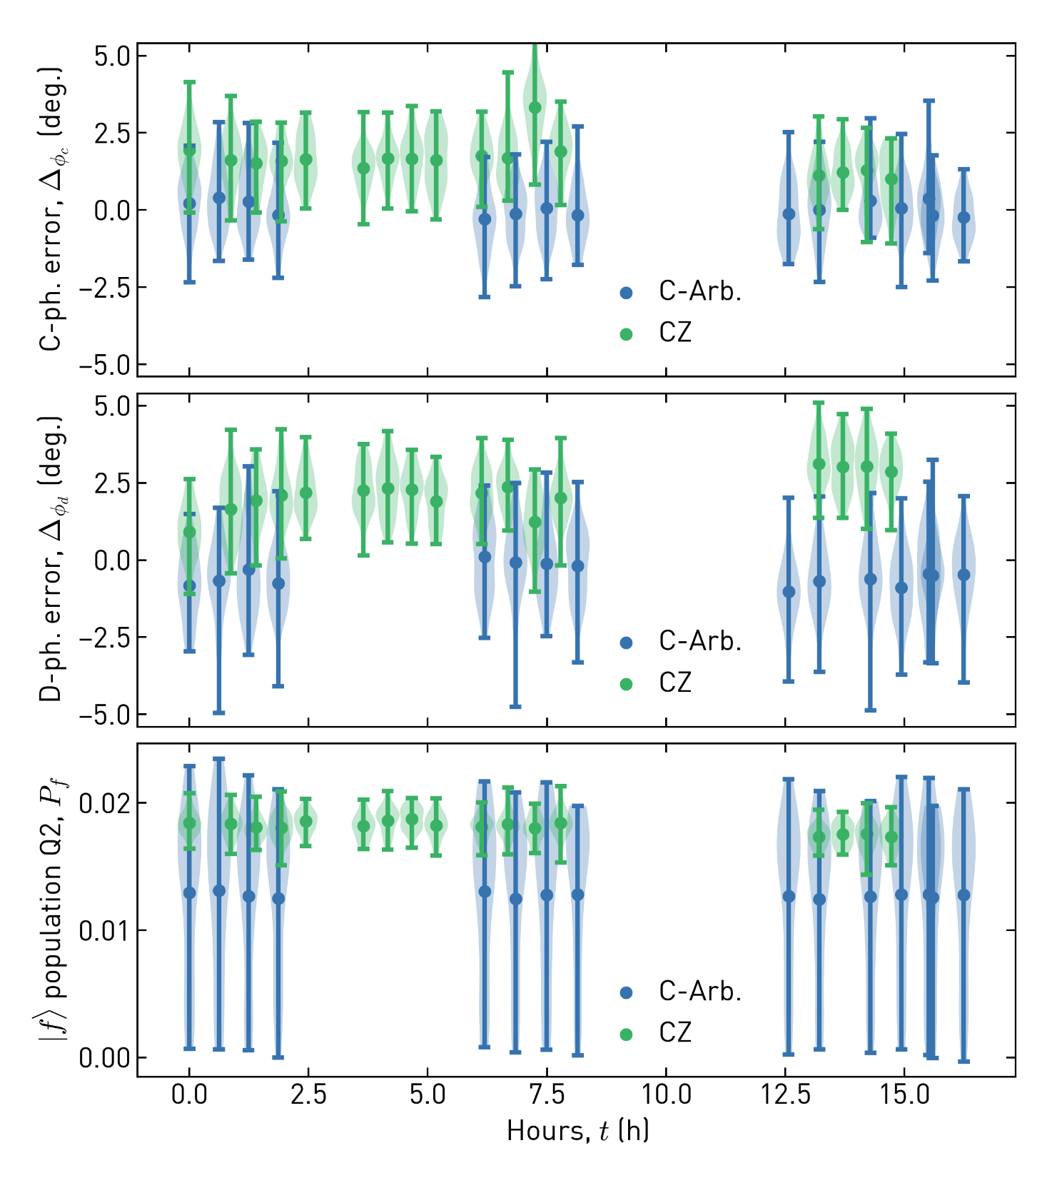
Comparison to CZ gate
Similar mean phase errors
Slightly larger distribution
Similar time stability
Lower average leakage (same worst leakage)
~ 20% shorter on average

Slide 12
Recap
Useful to implement directly hamiltonian terms which have arbitrary phases
Process tomography: F 97.3 – 98.3
Phase errors are small
Average leakage 1.4 %
Limitations:
Not easily compatible with NZ flux pulses
Long calibration time
→ Benchmark on a real use case

Slide 13
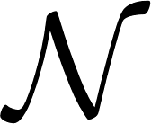
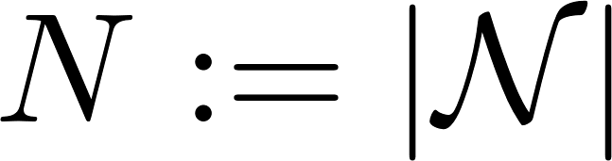
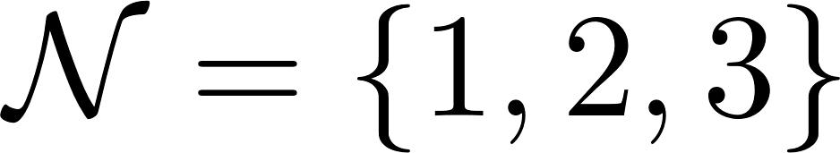
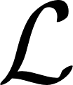
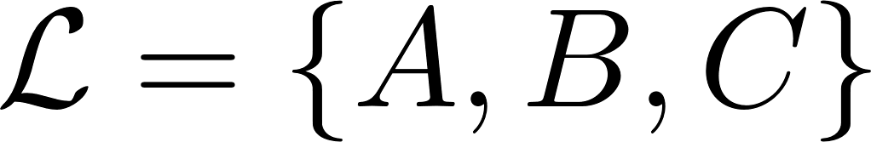
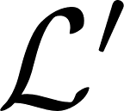
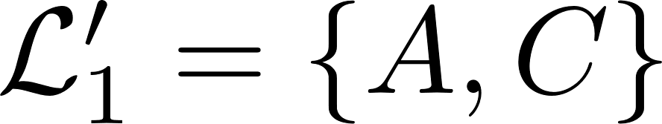
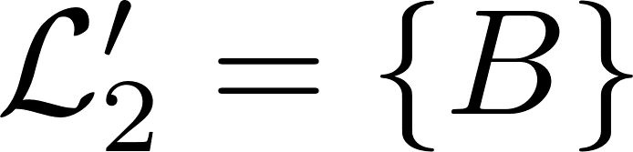
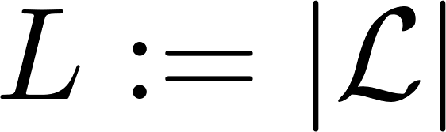
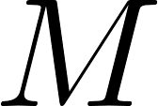
Exact Cover
Given a set and a collection of subsets of : with
Question: is there a subcollection of for which each element of is included exactly once?
Here :
→ Yes.
NP-complete decision problem
1
2
3
A
B
C
Garey, Michael R, and David S Johnson. 1990. Computers and Intractability; A Guide to the Theory of NP-Completeness. USA: W. H. Freeman & Co.

Slide 14
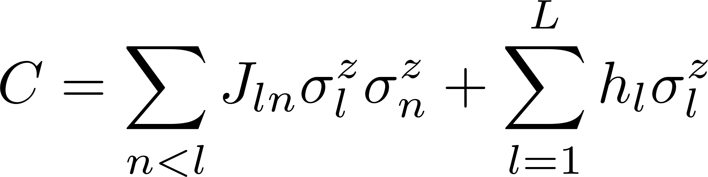
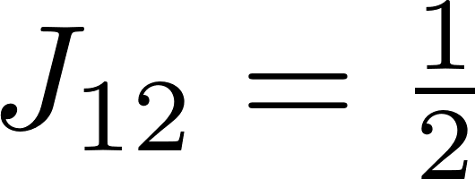
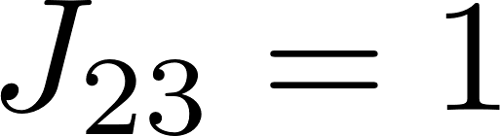


Exact Cover: Mapping to Ising model
The exact cover can be reformulated to
In this example:
Answers :
1
2
3
A
Q1
B
Q2
C
Q3
Karp, Richard M. 1972. “Reducibility among Combinatorial Problems.” In Complexity of Computer Computations, 85–103. Boston, MA: Springer US.
Notes:
J is the product of two rows (by column elements)
h is sum of (product of a column – 2)

Slide 15




Quantum Approximate Optimization Algorithm (QAOA)
Direct implementation
Decomposed implementation
Fahri (2014), Alternator Ansatz
Notes:
Introduced by Fahri (2014), later generalized as Quantum Alternating Operator Ansatz by Hadfield.
Hybrid quantum classical algorithm to find approximate solution to combinatory problems.
At the time it was introduced, provided the best approximation ratio on MAX-Cut (NP-complete). Now it is no longer the case and there is no evidence that QAOA will show a provable speedup vs best classical algo. Could provide practical speedup, not sure either. But well studied problem in literature, thus we benchmark our gates on it.

Slide 16


Parameter Landscape
Depth = 1
Noise free simulation
Direct implementation
Decomposed implementation
Notes:
- For a depth of 1 (1 layer), we have only two parameters (gamma1, beta1), so we can plot the entire parameter landscape
- Compare noise free simulation to

Slide 17

Notes:
Change to updated figure (axis, ps)

Slide 18







Slide 19


Slide 20
Conclusion

Slide 21
BACKUP SLIDES

Slide 22





Device
Q1
Q2
Q3
Adapted from C.K. Andersen et al. npj Quantum Inf 5, 69 (2019) doi:10.1038/s41534-019-0185-4

Slide 23






Single qubit 3L Readout

Slide 24

Device characterization: Multiplexed readout
Reproduced from C.K. Andersen et al. (2019)

Slide 25

Reset rate: Comparison to literature
Adapted from Magnard et al. (2018)
This work
Magnard et al. (2018)

Slide 26



Active Reset: Effect of Readout Correction

Slide 27
P is the class of decision problems which can be solved in polynomial time by a deterministic Turing machine.
NP is the class of decision problems which can be solved in polynomial time by a non-deterministic Turing machine. Equivalently, it is the class of problems which can be verified in polynomial time by a deterministic Turing machine.
NP-hard is the class of decision problems to which all problems in NP can be reduced to in polynomial time by a deterministic Turing machine.
NP-complete is the intersection of NP-hard and NP. Equivalently, NP-complete is the class of decision problems in NP to which all problems in NP can be reduced to in polynomial time by a deterministic Turing machine.
https://softwareengineering.stackexchange.com/questions/308178/trying-to-understand-p-vs-np-vs-np-complete-vs-np-hard

Slide 28


Mapping Exact cover to Ising Model

Slide 29

3 Level Single Shot Readout
Intro / Math
Two steps
RO frequency optimization
State assignment

Slide 30






Readout frequency optimization for single shot readout

Slide 31



3 level readout: analysis
Orange + green points here
Notes:
Questions:

Slide 32



3 level measurement-based active reset
Notes:
Question: readout pulse versus integration?
Parity paper: latency = 0.6 mu s

Slide 33


3 level measurement-based active reset
HDAWG
State prep.
Sample
FB
Code word
≈ 895 ns
UHFQA
RO pulse
Threshold
Integr.
Threshold
Integr.
x 2
x 2
Data acq.
Notes:
Question: readout pulse versus integration?
Parity paper: latency = 0.6 mu s

Slide 34




Statistically optimal versus thresholding state

Slide 35

Active reset: population evolution
Evolution of populations as function of reset repetitions for each state preparation
State preparation

Slide 36
Active reset: population evolution
Evolution of populations as function of reset repetitions for each state preparation
State preparation

Slide 37

Active reset: population evolution
Evolution of populations as function of reset repetitions for each state preparation
2 reset repetitions (~1.8 μs) to get below initial thermal population
State preparation

Slide 38

Active reset: population evolution
Evolution of populations as function of reset repetitions for each state preparation
2 reset repetitions (~1.8 μs) to get below initial thermal population
Reset to ground state 2 order of magnitude faster than without reset
State preparation
Notes:
Question : if f state pop without reset goes why not

Slide 39

Active reset: performance analysis
Evolution of populations as function of reset repetitions for each state preparation
2 reset repetitions (~1.8 μs) to get below initial thermal population
Reset to ground state 2 order of magnitude faster than without reset
Reset rate for state preparation: 0.6 MHz
Steady state excited population: 1.5 ‰

Slide 40
Active reset: performance analysis
Evolution of populations as function of reset repetitions for each state preparation
2 reset repetitions (~1.8 μs) to get below initial thermal population
Reset to ground state 2 order of magnitude faster than without reset
Reset rate for state preparation: 0.6 MHz
Steady state excited population: 1.5 ‰
Limitations:
Idle time (2018: 600ns, 2019: 440 ns, 2020: ?)
Decay (~1.8% for )
(Rethermalization)
Readout infidelity on (~0.2%)
Measurement induced transitions
Notes:
Question : remaining difference with reference measurement (4.6% ?)

Slide 41
P
P is a complexity class that represents the set of all decision problems that can be solved in polynomial time.
That is, given an instance of the problem, the answer yes or no can be decided in polynomial time.
Example
Given a connected graph G, can its vertices be coloured using two colours so that no edge is monochromatic?
Algorithm: start with an arbitrary vertex, color it red and all of its neighbours blue and continue. Stop when you run out of vertices or you are forced to make an edge have both of its endpoints be the same color.
NP
NP is a complexity class that represents the set of all decision problems for which the instances where the answer is "yes" have proofs that can be verified in polynomial time.
This means that if someone gives us an instance of the problem and a certificate (sometimes called a witness) to the answer being yes, we can check that it is correct in polynomial time.
Example
Integer factorisation is in NP. This is the problem that given integers n and m, is there an integer f with 1 < f < m, such that f divides n (f is a small factor of n)?
This is a decision problem because the answers are yes or no. If someone hands us an instance of the problem (so they hand us integers n and m) and an integer f with 1 < f < m, and claim that f is a factor of n (the certificate), we can check the answer in polynomial time by performing the division n / f.
NP-Complete
NP-Complete is a complexity class which represents the set of all problems X in NP for which it is possible to reduce any other NP problem Y to X in polynomial time.
Intuitively this means that we can solve Y quickly if we know how to solve X quickly. Precisely, Y is reducible to X, if there is a polynomial time algorithm f to transform instances y of Y to instances x = f(y) of X in polynomial time, with the property that the answer to y is yes, if and only if the answer to f(y) is yes.
Example
3-SAT. This is the problem wherein we are given a conjunction (ANDs) of 3-clause disjunctions (ORs), statements of the form
(x_v11 OR x_v21 OR x_v31) AND (x_v12 OR x_v22 OR x_v32) AND ... AND (x_v1n OR x_v2n OR x_v3n)
where each x_vij is a boolean variable or the negation of a variable from a finite predefined list (x_1, x_2, ... x_n).
It can be shown that every NP problem can be reduced to 3-SAT. The proof of this is technical and requires use of the technical definition of NP (based on non-deterministic Turing machines). This is known as Cook's theorem.
What makes NP-complete problems important is that if a deterministic polynomial time algorithm can be found to solve one of them, every NP problem is solvable in polynomial time (one problem to rule them all).
NP-hard
Intuitively, these are the problems that are at least as hard as the NP-complete problems. Note that NP-hard problems do not have to be in NP, and they do not have to be decision problems.
The precise definition here is that a problem X is NP-hard, if there is an NP-complete problem Y, such that Y is reducible to X in polynomial time.
But since any NP-complete problem can be reduced to any other NP-complete problem in polynomial time, all NP-complete problems can be reduced to any NP-hard problem in polynomial time. Then, if there is a solution to one NP-hard problem in polynomial time, there is a solution to all NP problems in polynomial time.
Example
The halting problem is an NP-hard problem. This is the problem that given a program P and input I, will it halt? This is a decision problem but it is not in NP. It is clear that any NP-complete problem can be reduced to this one. As another example, any NP-complete problem is NP-hard.
https://stackoverflow.com/questions/1857244/what-are-the-differences-between-np-np-complete-and-np-hard

